Slide 1
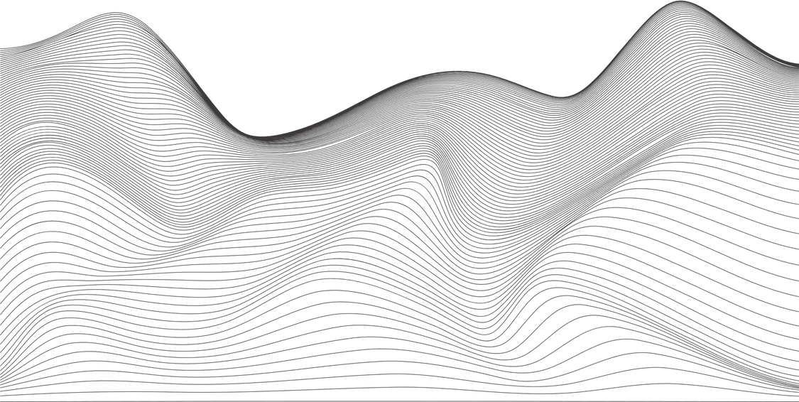















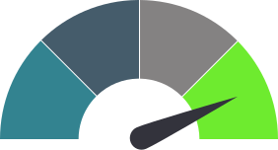





INTRODUCING
QBricks
TM
A.I. enabled metadata management
95%
Fewer data issues
70%
Cost reduction
Deploy in hours
Fully auditable
Databricks &
Microsoft level
security
The Data Challenge
Key QBricks Features
The need for high quality, governed and trusted data has never been higher. As organisations try to leverage their data for ever complex use cases and try to realise a competitive advantage with A.I. the demand for accurate data is only going to accelerate. In 2025, an MIT report showed that as many as 95% of A.I. related use cases were failing. The primary reason? Poor data quality and a lack of metadata management.
We recognised early on that without the right infrastructure and high quality data, organisations would struggle to get value from A.I. and the latest technologies. This is why we designed and built QBricks.
Introducing QBricks
QBricks enables the development and deployment of data quality and ETL workflows via the use of Data Contracts. It is an enterprise grade, cloud agnostic, and agentic enabled solution which provides significant time savings when compared to manually developed and deployed workflows.
Experience streamlined, efficient, and reliable Databricks and Microsoft Fabric workload deployments with QBricks.
Introducing QBricks: Your Comprehensive Metadata Management Solution
Seamless Integration
QBricks incorporates robust ETL and Data Quality frameworks, ensuring that every workload adheres to the highest standards.
User Friendly Interface
QBricks simplifies the management of your Databricks infrastructure through Data Contracts and Data Products, including the configuration of necessary compute resources. Contracts can be easily browsed.
Flexible Deployment Options
Utilise QBricks through our intuitive app interface or deploy it using Databricks' native tools. Whether it's ETL, Data Quality, Data Contracts, or Data Products, QBricks provides comprehensive support.
Efficient File Management. Fast Deployment
Eliminate the complexities of managing multiple files that become increasingly difficult to handle as they grow exponentially. QBricks requires only a single file to deploy everything, including infrastructure and workloads, enhancing efficiency and reducing errors.
Enhanced Data Understanding
QBricks leverages ontologies and knowledge graphs to provide a structured and interconnected view of your data, facilitating better data discovery, improved data quality, and informed decision-making.
Provides a structured, replayable history of how context turned into action.
Achieve knowledge alignment between decision-makers and field teams with QBricks. All processes are auditable via contracts, ensuring transparency and consistency across the organisation.
Breakdown Business Silos. Remove Misunderstandings
‘’Revolutionise your Databricks and Microsoft Fabric workload deployments with QBricks.
The sophisticated, governed and secure metadata management tool designed for optimal efficiency and ease of use’’
Agentic Enabled
QBricks significantly automates the metadata management process. Once deployed, agents learn, track decision lineage and continually improve the process. Everything is auditable and the human remains in the loop.
The ongoing process of managing metadata to ensure its accuracy, integrity, and usability throughout its lifecycle. This includes organising, cataloging, and governing metadata to improve data accessibility and compliance, which is crucial for modern data management practices.
QBricks enables Perpetual Metadata Management
Embeded Quantexa Trust Score
QBricks interfaces with Quantexa. If your organisation uses Quantexa, QBricks can ingest the trust score and embed it in the data assets and data product, for use across the organisation. Assure 99% data matching accuracy with Quantexa.
99%
Matching accuracy
QBricks works with
Want To Learn More?
Microsoft Fabric
sales@infinium.consulting
QBricks is a trademark of Infinium Consulting B.V. (pending)

